Slide 1

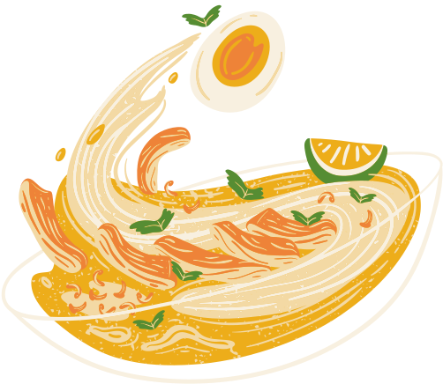
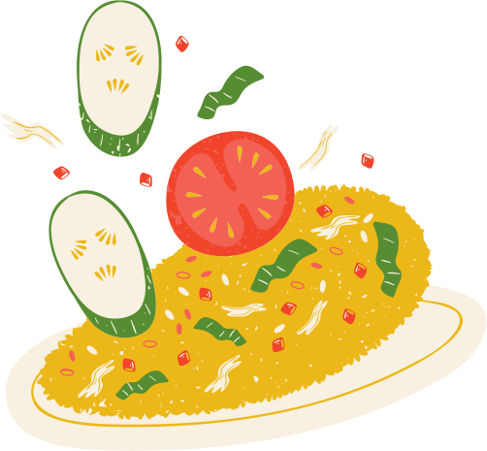
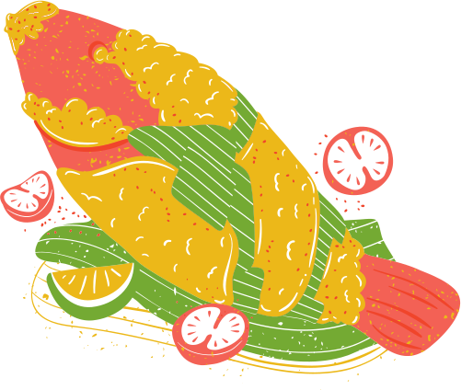
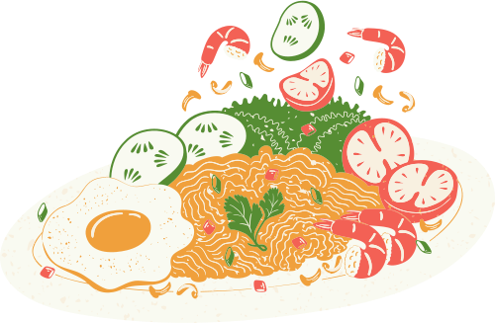
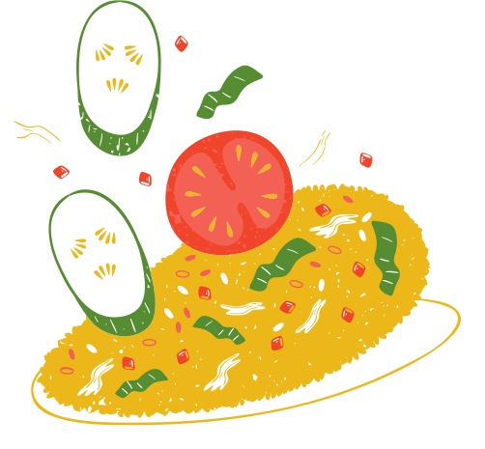
FOOD 101 OBJECT CLASSIFICATION

Slide 2
Team behind the Project
Ferhan Ahmed
Shikha Roy
Tanuj Pandey

Slide 3
Table Of Content
Introduction
Challenges, Objective and Models
Related Work
Proposed Work
Approach
Dataset Explanation
Training Process
Model Workflow
Evaluation and Final Result
Discussion and Conclusion

Slide 4
Introduction
The Role of Food in Our Lives:
Food is vital for our health, providing the nutrients needed for growth, energy, and overall well-being.
Where Food Image Classification Comes Into the Picture:
As the demand for automated systems in healthcare, nutrition, and retail industries grows, accurate food classification models have become increasingly important.
Definition:
Food classification is an essential task in the field of computer vision, involving the identification
and categorization of food items from images.
Image classification is the process of assigning labels to images based on their visual content.

Slide 5
Applications of Food Image Classification
Application of Food Image Classification:
The need for food classification arises in several key scenarios:
1. Dietary Management Apps: Users need to track their nutritional intake for health reasons.
2. Social Media and Content Organization: Need to organize and categorize these images for better searchability and content management.
3. Food Delivery and Recognition Apps: Ensures correct order processing and personalized recommendations.
4. Marketing and Advertising: Targets specific customer segments with tailored marketing campaigns, improving the effectiveness of their advertising efforts.
5. Research and Data Analysis: Aids in analyzing food images to gain insights into nutrition and consumer trends.
6. Cultural and Culinary Documentation: Assist chefs in identifying and categorizing various dishes for documenting and preserving culinary traditions, making it easier to study and share different cuisines globally

Slide 6
Challenges, Objective and Models
Challenges:
Visual Similarities: Differentiating between visually similar food items.
Variations in Appearance: Handling variations due to different angles, lighting, and presentation.
Objective of the Study:
To Develop a machine learning model to classify food items using the Food Object 101 dataset.
Models Explored:
Basic CNN Ensemble: Initial approach with limited success.
Ensemble of Pretrained VGG16 Models: Improved accuracy with transfer learning.
Single Pretrained VGG16 Model: Achieved the highest accuracy.

Slide 7
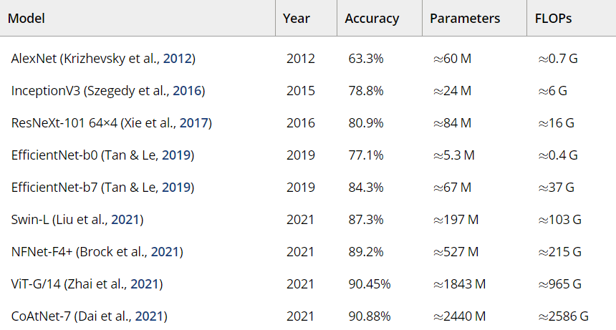
Related Work
Bossard et al. (2014): Used Random Forests for food image classification, achieving 50.76% accuracy. Highlighted the challenges of earlier machine learning approaches.
Lu (2015): Implemented CNNs with data augmentation, improving accuracy to 90%. Dataset size was a limiting factor.
Liu et al. (2016): Developed DeepFood
model using Inception modules, achieving
77.4% accuracy on the Food-101 dataset.
Showcased the power of deep learning in
complex image classification tasks.
Recent Advances:
Ensembling Techniques: Improved accuracy and
robustness by combining multiple models.
Kim et al. (2022) & Huang et al. (2023): Integrated
attention mechanisms with GANs for enhanced model performance.

Slide 8
Proposed Work
Initial Approaches:
Basic CNN Ensembling:
Used three identical CNN models.
Features from these models were concatenated before classification.
Pretrained VGG16 Ensembling:
Utilized pretrained VGG16 models.
For each input size (64x64, 96x96, 128x128), a VGG16 model is loaded without its top layers
(fully connected layers). This base model is used for feature extraction, and its weights are
frozen (i.e., not updated during training).Enhanced feature extraction with deep architecture.
Final Approach:
Single Pretrained VGG16 Model:
This approach uses transfer learning with a pretrained VGG16 model. The model is customized
with dense layers, data augmentation, and optimized using early stopping and learning rate reduction.

Slide 9
Approach
Selection of Pretrained Model:
VGG16 Model:
Chosen for its proven performance in image classification tasks.
Pretrained on the large-scale ImageNet dataset, providing strong feature extraction capabilities.
Model Customization:
Adapting VGG16:
The top layers are removed, and the remaining layers are frozen to use pre-learned features. Added Dense and Dropout layers improve feature extraction specific to the dataset. Fine-tuning was performed to adjust the weights of the pretrained model, making it more effective for the specific task of food classification.

Slide 10
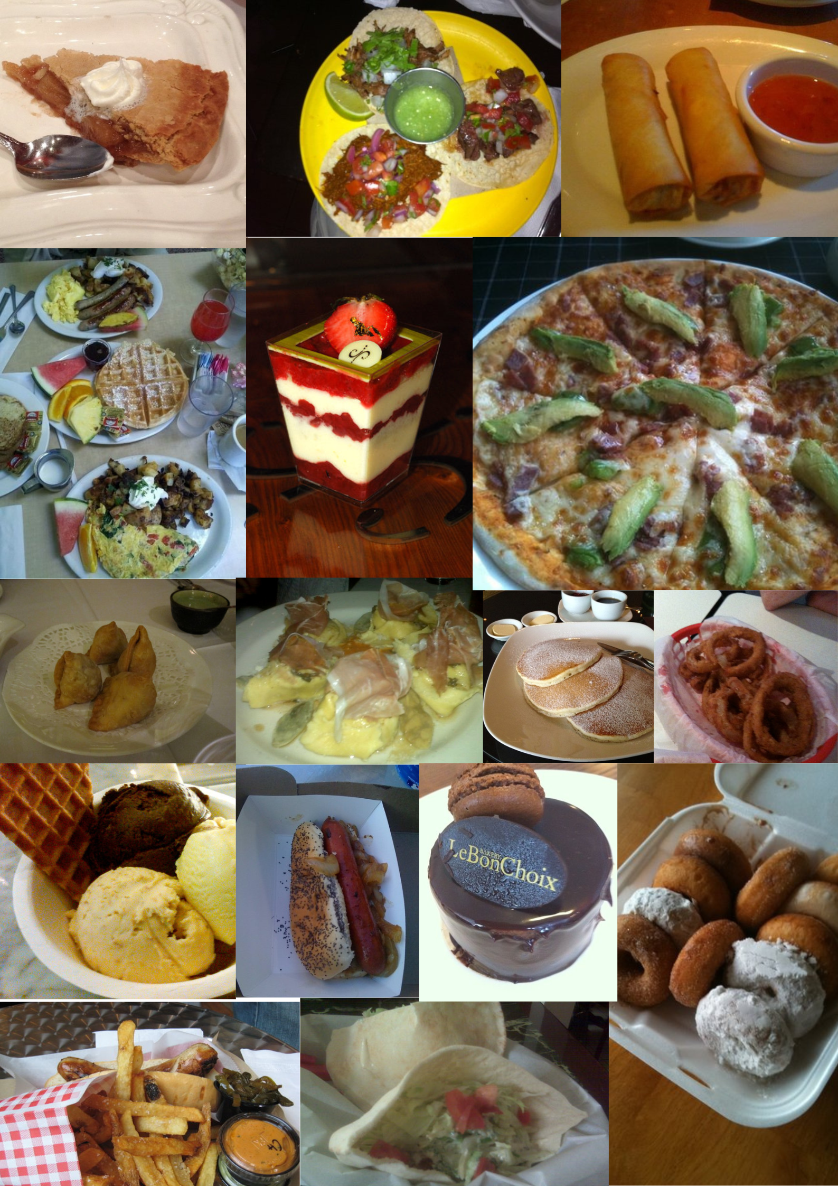
Dataset Explanation
Source: Food-101 dataset by Lukas Bossard et al.
Link: Food-101 on Kaggle
Original Dataset: 1,01,000 images across 101 food categories.
Subset Used:
Total Images: 8,125 images.
Categories: 17 food classes (e.g., ravioli, samosa, Falafel).
Sample Size:
500 images from each of 16 categories.
125 images from the 'apple pie' category.
Sample Dataset

Slide 11
Data Structure:
Organization: Images are categorized into folders by food class.
Split: Data is divided into training and testing sets.
Data Augmentation :
Purpose: To Enhance Model Performance
Techniques:
Rescale: Normalize pixel values.
Shear: Slant images slightly.
Zoom: Randomly zoom in/out.
Flip: Flip images horizontally.
Rotate: Rotate images up to 30°.
Shift: Move images horizontally and vertically.
Fill Mode: Fill gaps with 'nearest' pixels.

Slide 12
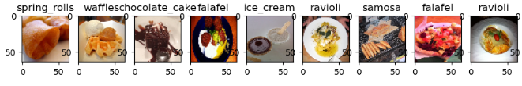
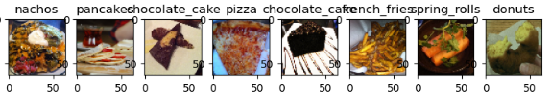
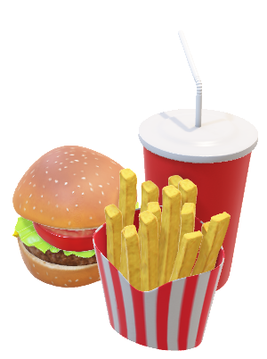
Exploratory Data Analysis (EDA) And Visualization:
Pictures from 17 distinct cuisine groups were included in the dataset utilized for this investigation. A 70:30 ratio was used to divide the total number of photos into training and testing sets. After uploading and analysis, we visualize the data:

Slide 13
Training Process
Preprocessing:
Image Resizing: Scaled images to 128x128 pixels.
Data Augmentation: Used techniques like rotation, shifting, and flipping to diversify training data.
Model Training:
Hyperparameter Tuning: Adjusted learning rate, batch size, and epochs for optimal performance.
Fine-Tuning: Customized the pretrained VGG16 model to improve food image classification.

Slide 14
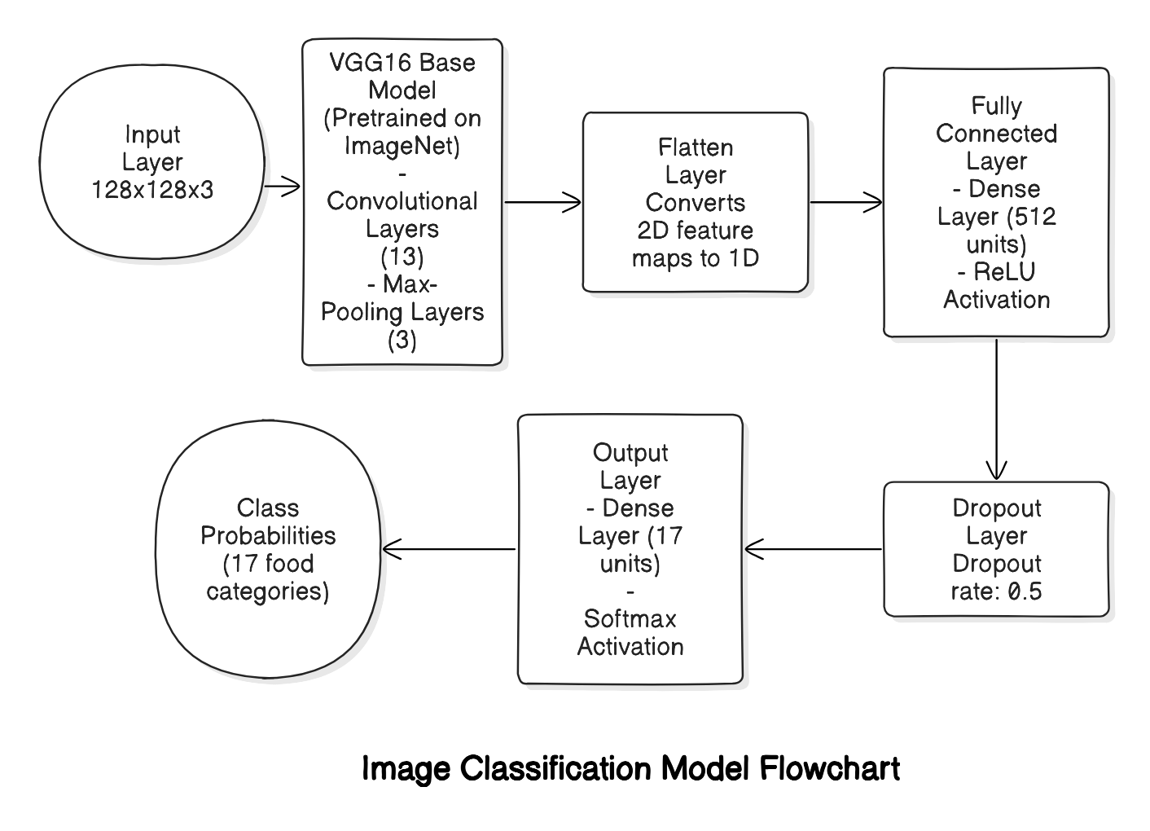
Model Workflow

Slide 15
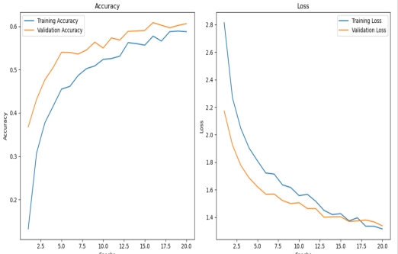
Evaluation and Final Result
Evaluation
Using the test set, the model's performance and accuracy were evaluated. Metrics including accuracy and loss were monitored throughout training.
Result
1. Easy CNN assembling method – 27.7% accuracy
2. Ensemble of pre-trained VGG16 models – 45.6% accuracy
3. pre-trained VGG16 - 60.6% accuracy
Single pretrained VGG16 Model outperformed both with great use of deep feature.

Slide 16
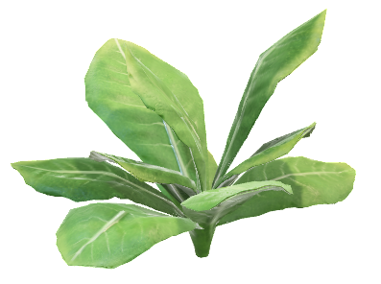
Discussion and Conclusion
Discussion points
High degree of variability affecting accuracy of models
Feature extracting and model complexity
Importance of Data Augmentation
Dataset Bias and generalization
Emerging trends and technologies
1
Pretrained VGG16 Model Outperformed both the CNN ensemble and the ensemble of pretrained VGG16 models.
Pretrained VGG16 model outperformed is showing superior accuracy due to transfer learning and VGG16's robust architecture. The CNN ensemble had limited performance due to simpler feature extraction, while the ensemble of pretrained VGG16 models showed improved accuracy but not significantly better than the single pretrained model.
2
3
For future work, we aim to refine pretrained models for improved accuracy, explore advanced architectures, and apply additional data augmentation techniques to boost model generalization.
Utilizing advanced architectures and pretrained models is crucial for improving food image classification performance.
4

Slide 17
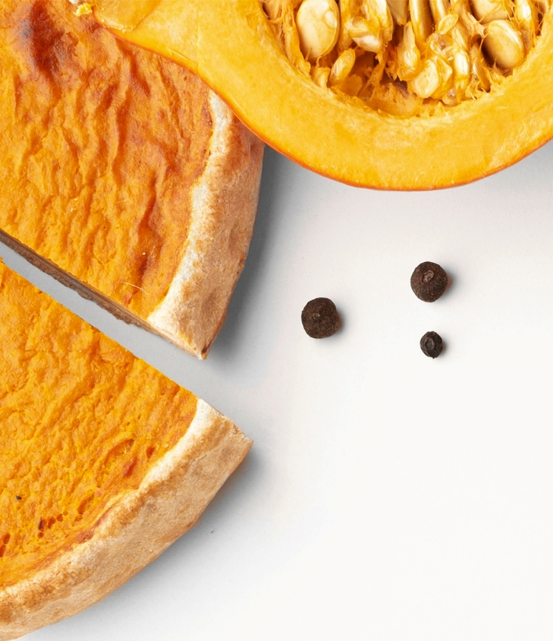
Thank You

